Slide 1
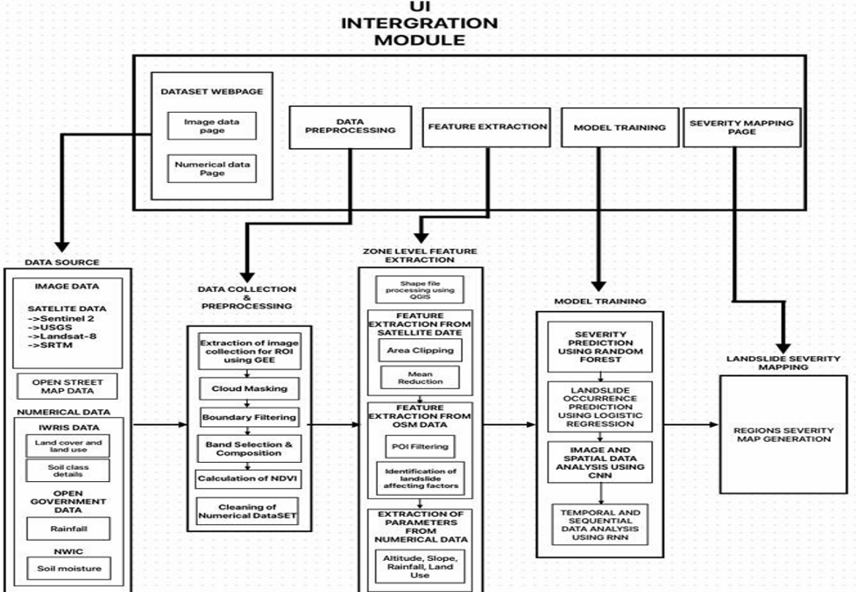
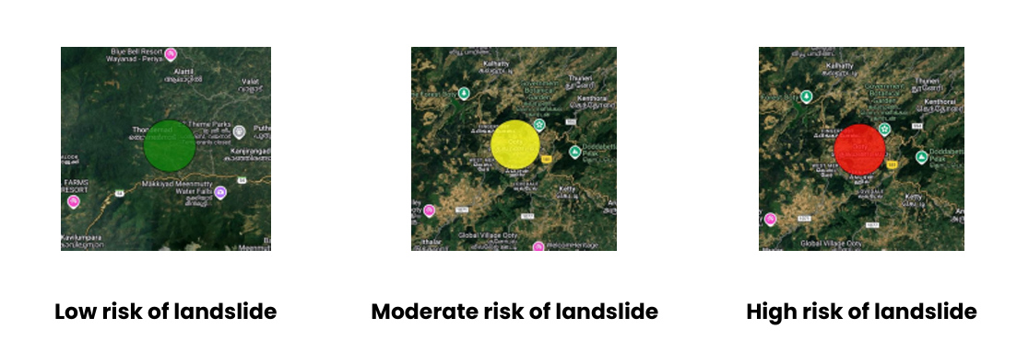
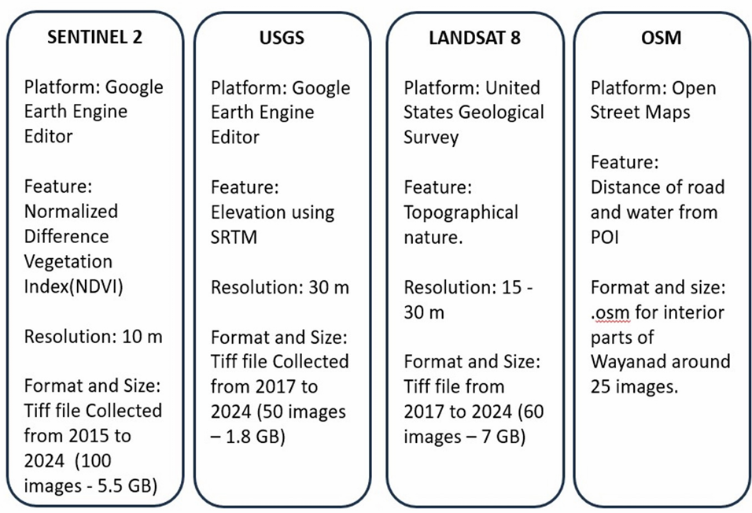
Slideguard : Landlside Risk Assessment - Wayanad
TEAM MEMBERS:
Thiyaneshwar T (2022115136) J Soham Panda(2022115024) Aniketh B Balaji(2022115052)
Abstract
System Architecture
Landslide Risk: Landslides are a major threat to infrastructure, human life, and the environment, particularly in areas with complex terrain and varying climatic conditions.
Limitations of Traditional Methods: Existing prediction methods often suffer from low accuracy due to insufficient data integration and the complexity of influencing factors.
Project Aim: To develop a precise and scalable landslide prediction and severity mapping system.
Data Fusion: Utilize multi-source data including: Satellite imagery, Geospatial data, Numerical datasets (e.g., rainfall, soil type, elevation)
Technological Approach: Leverage advanced Machine Learning (ML) and Deep Learning (DL) models.
Outcome: Transform complex datasets into actionable insights.
Applications: Enhance early warning systems and support disaster management.
Social Relevance
Disaster Management: Enables early warnings, reducing casualties and improving evacuation planning.
Infrastructure Protection: Helps safeguard roads, bridges, and buildings by identifying high-risk zones.
Environmental Conservation: Prevents deforestation and soil erosion by monitoring terrain stability.
Urban & Rural Planning: Assists in sustainable land-use planning to minimize disaster impact.
Real-World Impact: Events like the 2024 Wayanad disaster show the urgent need for accurate prediction models.
Results
Workload/Module Splitup
Data Collection & Preprocessing
Satellite Data (ISRO, NASA –Sentinel-2)
OpenStreetMap (OSM) Data
Numerical Data (IWRIS – Rainfall, Land Resources)
Preprocessing: QGIS, GEE-API, Cloud Masking, NDVI Calculation
Zone-Level Feature Extraction
Satellite Data: Area Clipping, Mean Reduction
OSM Data: POI Filtering, Landslide Factors Identification
Numerical Data: Altitude, Slope, Rainfall, Land Use
Machine Learning Model Training
Random Forest – Severity Prediction
Logistic Regression – Landslide Occurrence Prediction
CNN – Image & Spatial Data Analysis
Landslide Severity Mapping
GIS-based Severity Zone Visualization
Real-time Risk Mapping & Monitoring
Technologies
Programming language: Python
Model Training and Experimentation Platforms: Google colab
Geometry extraction: QGIS (Quantum Geographic Information System)
Image extraction, cloud masking, bound filtering, band composition, and index calculations: GEE (Google Earth Engine) API
Custom scripting and advanced data analysis: Python Libraries (Geopandas , Shapely,Pandas, NumPy)
Machine Learning Frameworks: Scikit-learn
Deep Learning Frameworks: TensorFlow/Pytorch/Keras
Details Of Data
Conclusion
By leveraging the fusion of satellite imagery, geospatial intelligence, and environmental datasets with cutting-edge AI techniques, this project addresses the limitations of traditional prediction models. The resulting system provides a scalable, data-driven framework for landslide risk assessment and real-time monitoring, promoting resilience in vulnerable regions.

